Slide 1

amazon
AMAZON SALES
DATA ANALYSIS REPORT
SUMIT SINGH – S7344

Slide 2
01
Objective of Analysis
02
Business Problems – Need to be solved
03
Exploratory Data Analysis
04
Product Analysis
CONTENTS
05
Sales Analysis
06
Customer Analysis
07
Improvement – Need to be Done
08
Conclusion
09
Thanks Slide

Slide 3
OBJECTIVE OF ANALYSIS
"To analyze Amazon sales data to gain insights into customer behavior, product performance,
and sales trends, with the aim of identifying opportunities for optimization and growth. This
analysis will provide actionable recommendations to enhance customer satisfaction, drive sales
revenue, and improve overall business performance."

Slide 4
BUSINESS PROBLEMS – NEED TO BE SOLVED
1. Customer Segmentation: Understanding the diverse customer base to tailor marketing strategies, product offerings, and customer experiences.
2. Product Performance: Evaluating the sales performance of different product lines to optimize inventory management, promotions, and product development efforts.
3. Branch Optimization: Analyzing the performance of each branch/location to optimize resource allocation, improve operational efficiency, and enhance customer service.
4.Payment Method Effectiveness: Assessing the effectiveness of various payment methods in facilitating transactions and optimizing payment processes to enhance customer satisfaction and streamline operations.
JEFF BEZS
Founder

Slide 5
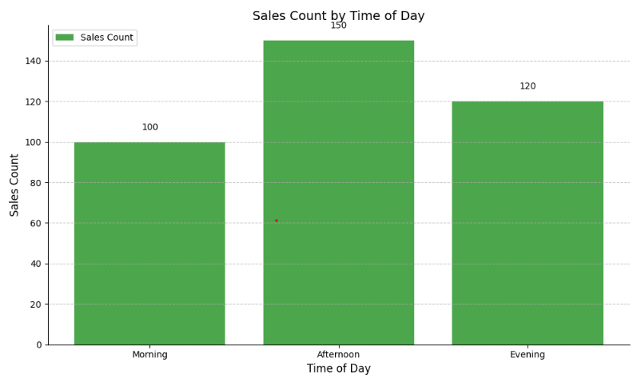
amazon
EXPLORATORY DATA ANALYSIS
amazon
Q1. Count of Sales at which time of a day is Highest and Lowest?
OBSERVATION:-
From the graph, we observe that Sales counts are Highest in the Afternoon, Followed by the evening, with the Morning showing the Lowest sales count among the three time periods.
amazon

Slide 6
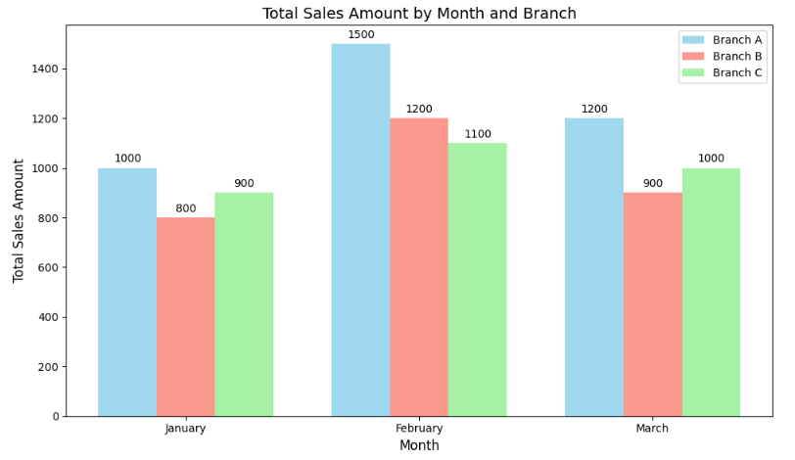
amazon
EXPLORATORY DATA ANALYSIS
amazon
Q2. Which Branch has Highest sales and which one have Lowest?
OBSERVATION:-
From the graph, we observe that Sales counts are Highest in the Branch A, Followed by the Branch C, Branch B is having the Lowest sales count among the three Branches.
amazon

Slide 7
Product Analysis
Health and Beauty
- Among the top-selling product.
- Generates consistent revenue across all branches and months.
- Preferred by both male and female customers.
Electronic Accessories
- Another popular product line.
- Shows variability in sales across branches and months.
- Most commonly purchased in the evenings.
Home and Lifestyle
- Moderate sales compared to other product lines.
- More popular among female customers.
- Sales peak observed on weekends.
JEFF BEZS
Founder

Slide 8
Product Analysis
Sports and Travel
- Relatively lower sales compared to other categories.
- Consistent performance across branches.
- More commonly purchased by males.
Food and Beverages
- Shows potential for growth, particularly in Mandalay branch.
- Preferred payment method: Credit card.
- Strong sales observed in February.
Fashion Accessories
- Least popular product line.
- Limited sales across all branches and months.
- Majority of purchases made by females.
JEFF BEZS
Founder

Slide 9
Recommendations of Product Analysis:-
- Increase marketing efforts for Fashion Accessories to boost sales.
- Explore strategies to enhance sales of Sports and Travel products.
- Offer targeted promotions for Food and Beverages to capitalize on peak sales months.
- Continuously monitor and analyze sales trends to adapt strategies accordingly.
JEFF BEZS
Founder

Slide 10
Sales Analysis
Branch Performance
- Branch A in Yangon had the highest number of sales across all months.
- Branch B in Mandalay showed consistent sales growth over the period.
- Branch C in Naypyitaw had the lowest sales compared to other branches.
Sales by Product Line
- Health and beauty products were the top-selling category, followed by Electronic accessories and Home and lifestyle.
- Fashion accessories had the lowest sales among all product lines.
Customer Behavior
- The majority of customers were members, contributing significantly to sales.
- Female customers made more purchases compared to male customers.
- Most purchases were made using e-wallets and credit cards.
JEFF BEZS
Founder

Slide 11
Sales Analysis
1. Promotional Strategies:
- Focus on promoting Health and beauty products due to their popularity.
- Introduce targeted promotions for Fashion accessories to increase sales.
2. Customer Engagement:
- Offer incentives for customers to become members to drive repeat purchases.
- Implement marketing campaigns targeting male customers to balance gender-based sales.
3. Payment Methods:
- Encourage the use of e-wallets and credit cards by offering discounts or cash back.
4. Timing of Promotions:
- Schedule promotions during the afternoon to capitalize on peak sales hours.
Time Analysis
Afternoon was the peak time for sales across all branches and months.
- Weekends showed higher sales compared to weekdays.
Recommendations:-
JEFF BEZS
Founder

Slide 12
Customer Analysis
1. Demographic Distribution
- Gender Distribution: There is a balanced distribution of male and female customers in the dataset. But females are the one who purchase more products as compare to men.
- Customer Type: Customers are categorized as either "Member" or "Normal,“. Member customer type is more active as compare to Normal one.
2. Purchase Behavior
- Product Line Preferences: Customers show preferences across product lines, But "Electronic accessories" being the most purchased category.
- Branch Preferences: Branch A is outperforming all other branch but the Branch which have lowest preference is Branch B.
3. Customer Engagement
- Payment Method Analysis: The payment method which mostly used is E-Wallets and least preferred is Credit Card
JEFF BEZS
Founder

Slide 13
Improvements - Need to be Done
Sports and Travel is not performing up to the mark amazon needs to introduce strategies to enhance sales of
Sports and Travel products.
2. Amazon should provide discount on Credit Card Payment methods to capture more market size.
3. Special offers should introduce for Food and Beverages product line to capture more sales in peak time.
4. Amazon should introduce more offers on Branch C as it is not performing up to the mark.
JEFF BEZS
Founder

Slide 14
Conclusion
Branch A is the best performing Branch.
Afternoon is the peak time for the sales.
Health and Beauty, Electronic Accessories are the top hot selling product lines
Fashion Accessories mostly purchased by female gender.
E-Wallets is the most popular payment method amongst all.
Weekends have more sales as compare to Weekdays.
JEFF BEZS
Founder

Slide 15
thanks!

